Slide 1
Predicting the Oscars: WHO WILL WIN BEST PICTURE FOR 2018
A Feature Presentation brought to you by:
Sara, Jesse, Tao, Steve

Slide 2
I: BOOTCAMP PROJECT
…With the Academy Awards fast approaching, the internet is abuzz with bias-free remarks on who and what will take home the most honourable awards in the industry.
Without hesitation, SealTeam6 embarked on their journey to determine the attributes of Oscar-nominated films, what trends exist in winning and losing movies, what it takes to be nominated, and to ultimately predict what film will likely take home the 91st Academy Award for Best Picture.
Armed with some of the most powerful predictive tools in the universe, and powered by Python, their journey began…

Slide 3
Act One: API Calls and Data Sources (1944-2015, with 388 Best Picture nominees in that time) Act Two: Data Munging Act Three: What does it take to win? Trends between the 73 winners and 315 losers in the 388 nominees Act Four: What does it take to be nominated? Trends between 5000 movies (388 nominees inclusive) Act Five: 2018 Prediction

Slide 4
ACT ONE: APIs & Data Sources
CSV Data sources:
Oscars Data 1934-2015 (Best Picture was introduced in 1944), extracted movie titles to run queries on APIs
5000 film csv
APIs used:
OMDB
From csv, extracted nominees and winners for best picture into list of title names.
Ran a loop that called the API and pulled data.
Queries by movie title and release year.
The Movie Database (TMDB)
From csv, extracted nominees and winners for best picture into list of title names.
Ran a loop that called the API and pulled data.
Queried by movie name
Error Handling: added a duplicate movie ID, that could later be found and understood as a error call.

Slide 5
ACT TWO: DATA MUNGING
CHALLENGES FACED:
Remakes of movies with the same title (e.g. Moulin Rouge made in 1952 and 2001)
Movie titles being different between different data sources (e.g. “All About Eve’ vs. “All about Eve”. Affected merging.
Movie info being on one source and not the other. Reduced Oscar nominees from 388 titles to 384 titles.

Slide 6
ACT THREE: What does it take to win Best Picture?
Features:
Genre
Cross-nomination
Month of Release
Revenue
Viewer Ratings
Rating

Slide 7
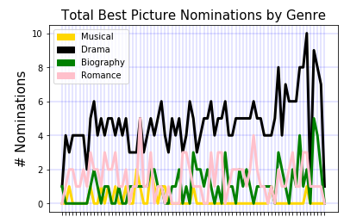
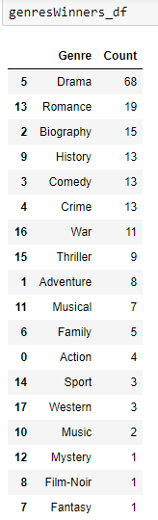
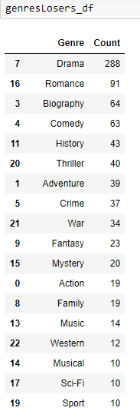
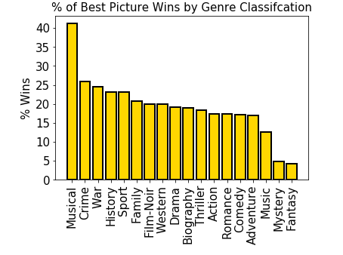
ACT THREE: Genre

Slide 8
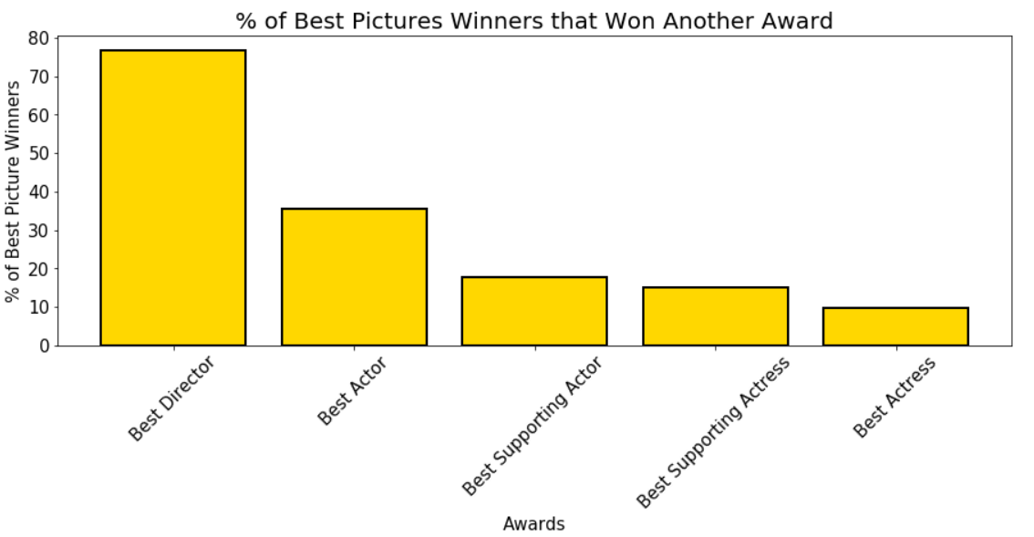
ACT THREE: Cross Nominations
Findings:
77% of winners also won Best Director
36% of winners also won Best Actor
18% of winners also won Best Supporting Actor
15% of winners also won Best Supporting Actress
10% of winners also won Best Actress

Slide 9
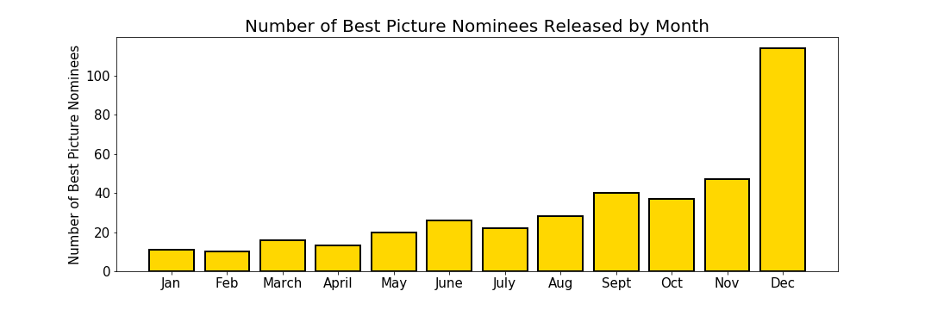
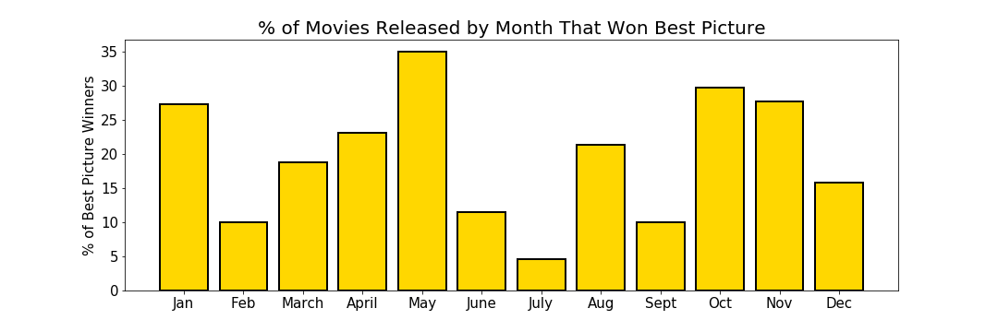
ACT THREE: Month of Release
Findings:
Most Best Picture Nominees are released later in the year, especially December. Good movies are getting drowned in a sea of good movies in Dec.
Findings:
A large proportion of the movies that are released in the middle of the year (May) are winning Best Picture.

Slide 10
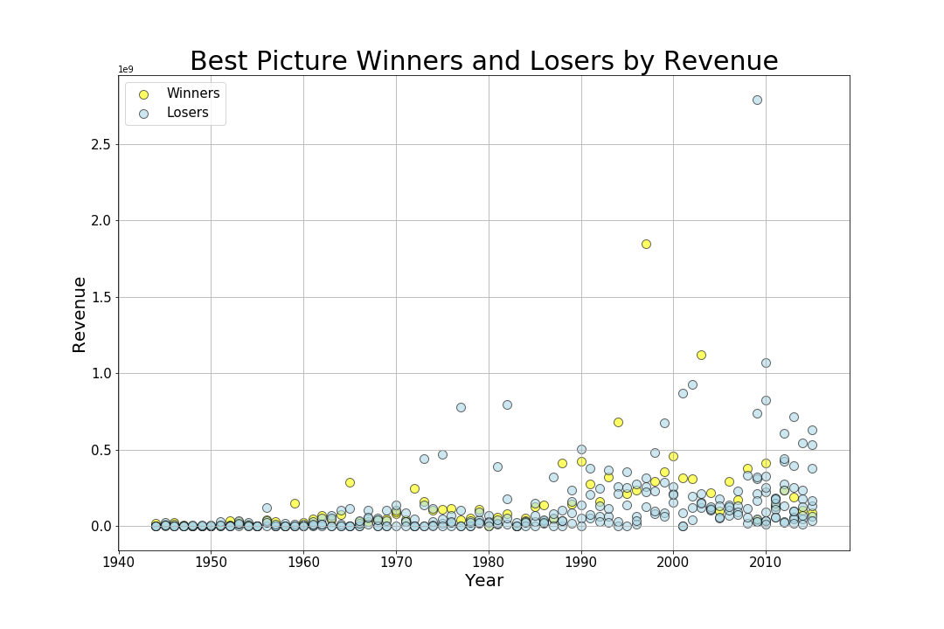
ACT THREE: Budget / Revenue
WATER WORLD

Slide 11
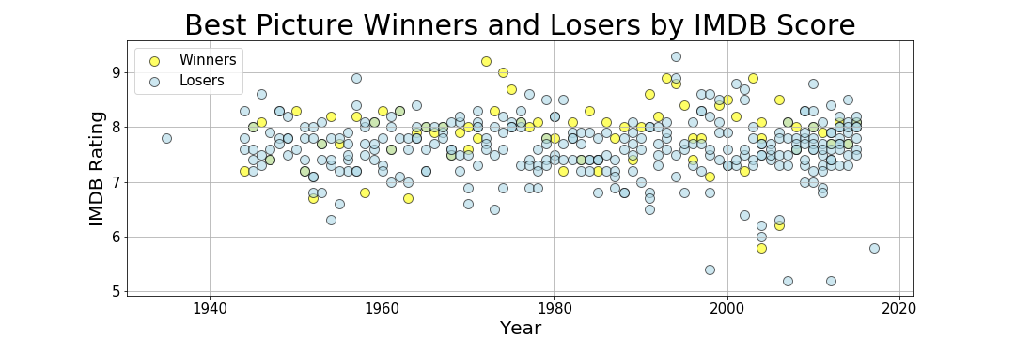
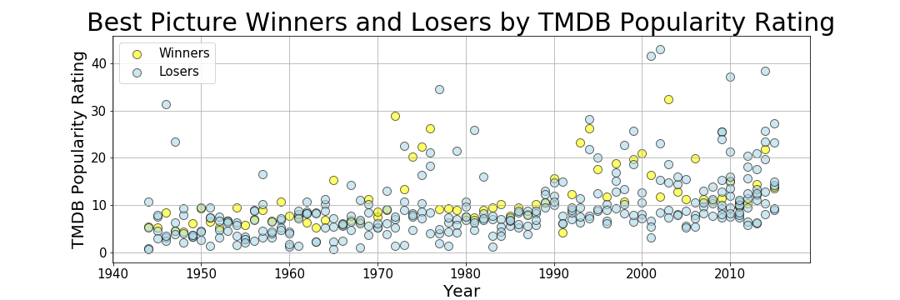
ACT THREE: Viewer Ratings

Slide 12
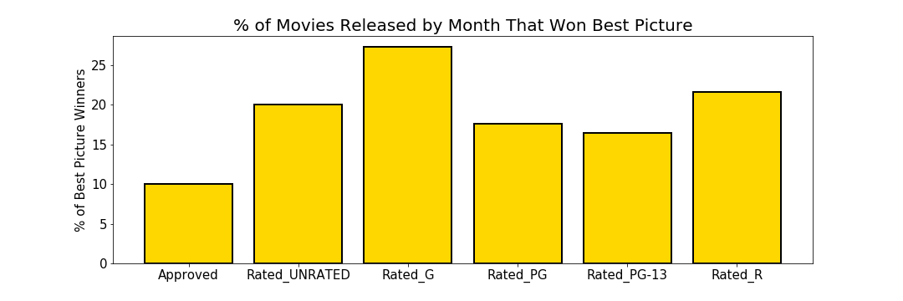
ACT THREE: Rating
Do Not be Deceived!

Slide 13
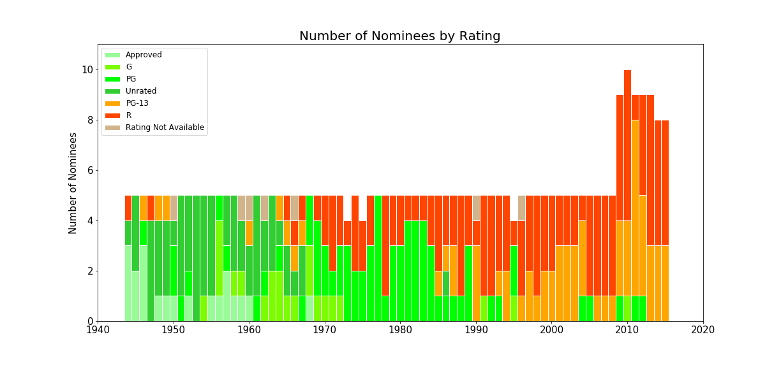
ACT THREE: Rating

Slide 14
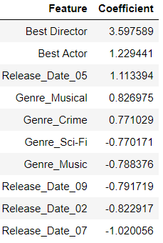
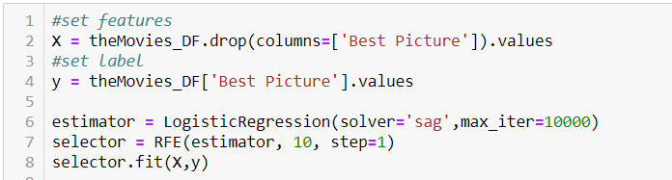
ACT THREE: Recursive Feature Elimination
Weight is assigned to each of the 49 features inputted through Logistic Regression (estimator). Then the least important feature are recursively pruned from the set of features until the top 10 most influential features are reached.

Slide 15
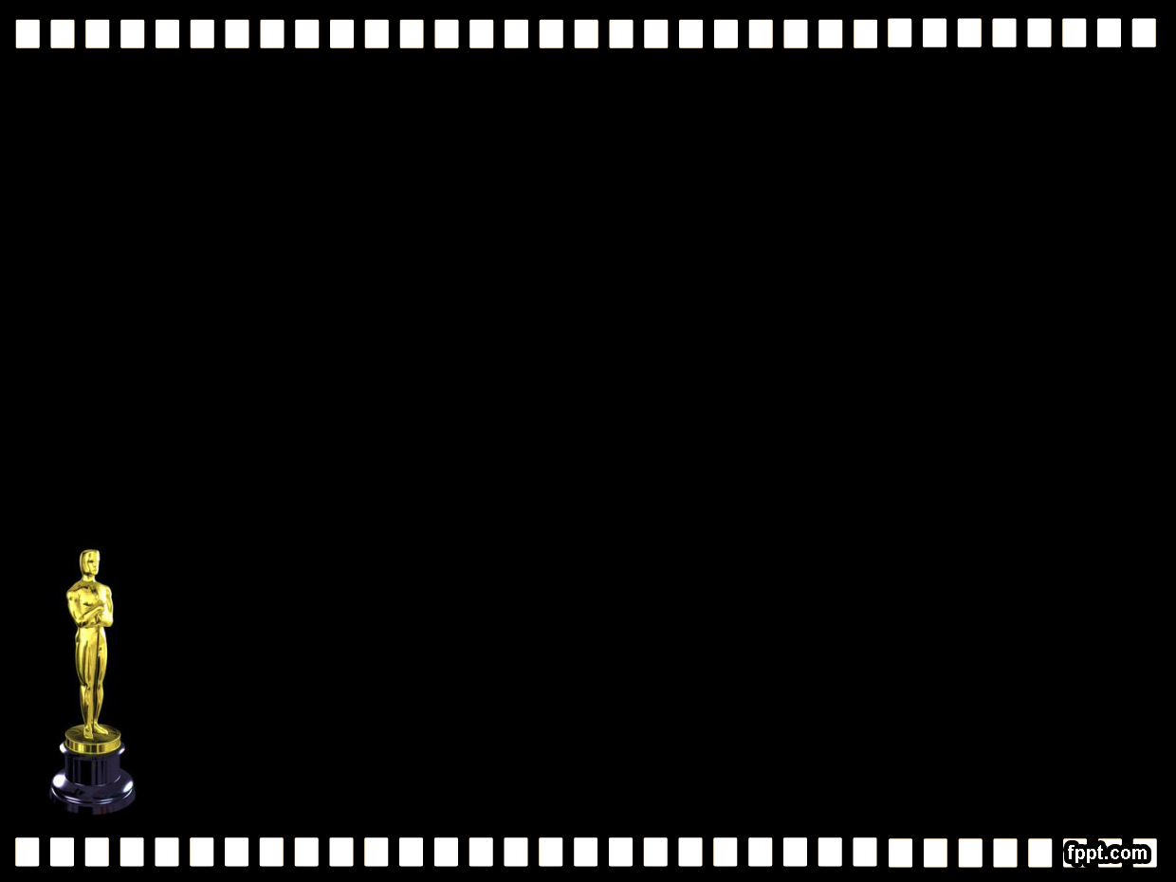
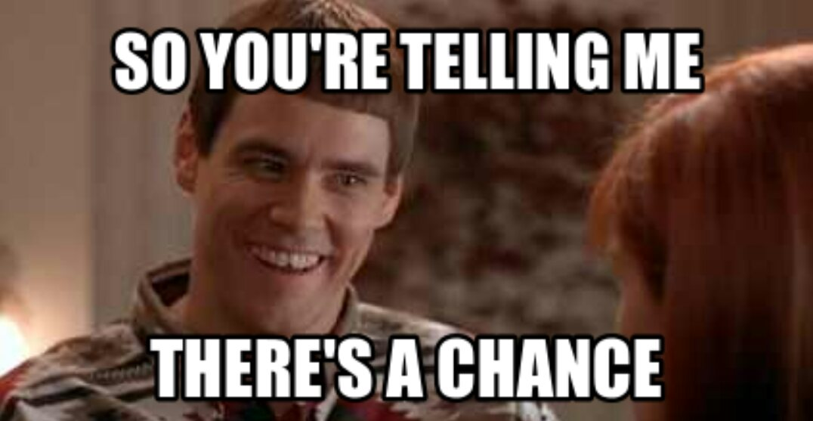
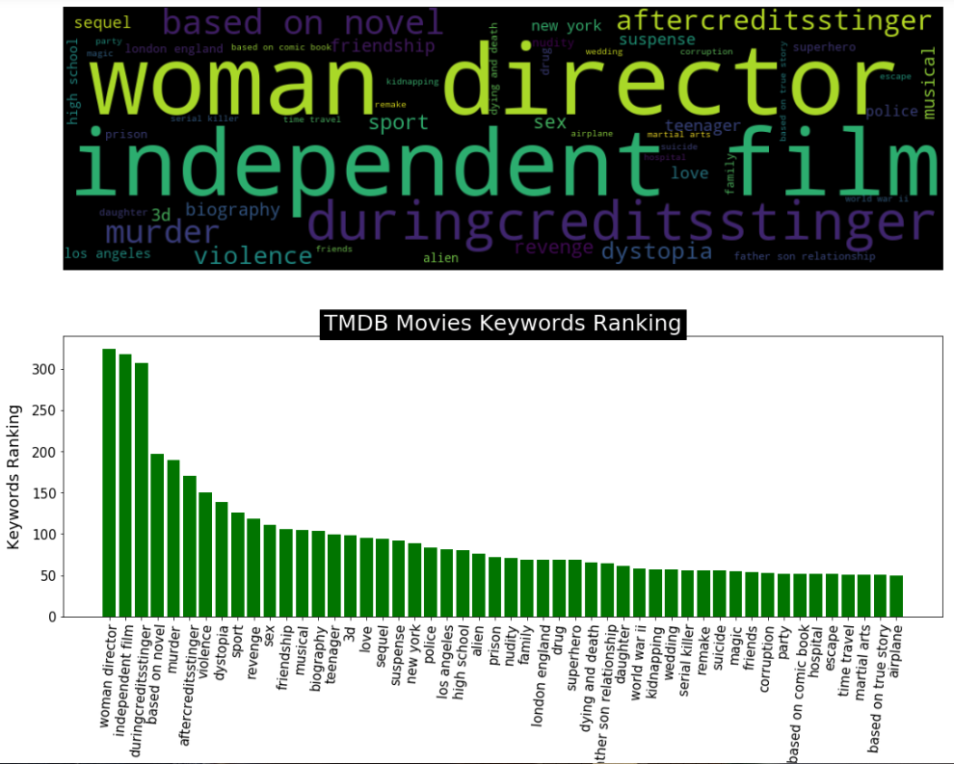

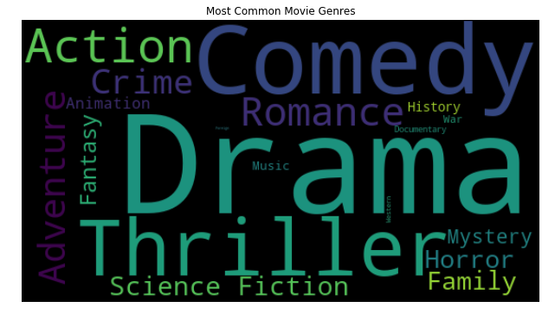
ACT FOUR: What does it take to be Nominated?
Oscar Nomination Prediction Model Pipeline
Data Set: TMDB 5000 Movies data and API query
Data Preparation:
Movie Title >>API query >> TMDB id >> Detail Movie Information
Feature Extraction
budget, revenue, rate, genre, release date, etc.
Test Data and Model Training (5000/w 383 labeled data)
Predictions and Model Tuning
5000 Movie Genres and Keywords Overview

Slide 16
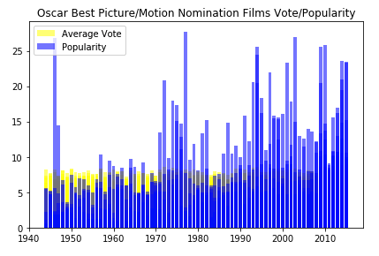
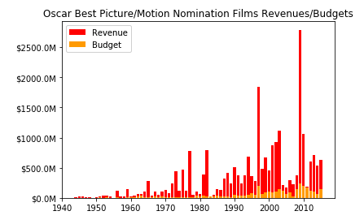
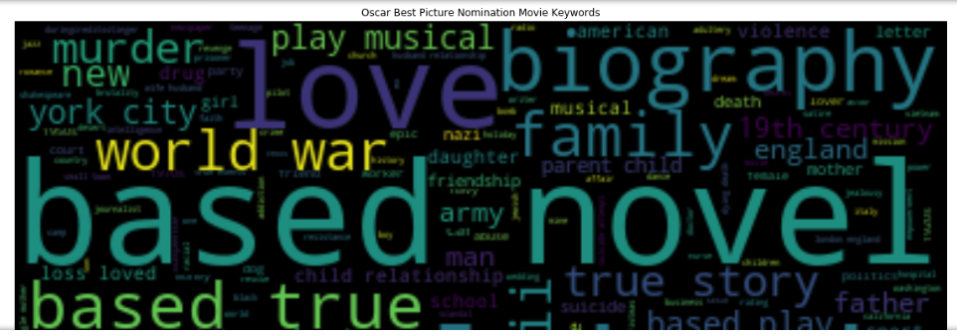
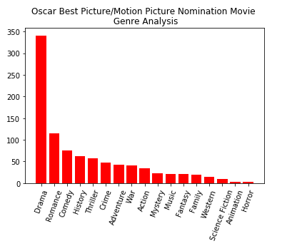
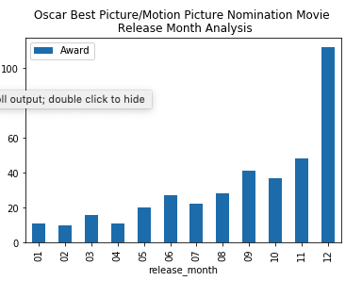
ACT FOUR: What does it take to be Nominated?
What factors are really matters to get the Oscar Best Picture Nomination?
Movie related: genres, keywords, runtime
Viewers related : vote_average and vote_count
Time related: release_date
Money related: revenue, budget
others
Historical Oscar Best Picture Movie
Nomination Analysis

Slide 17
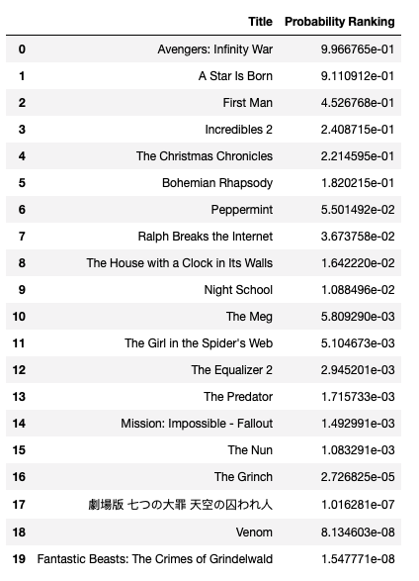
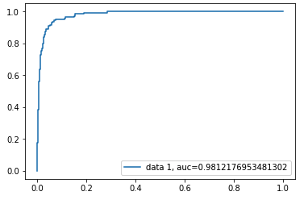
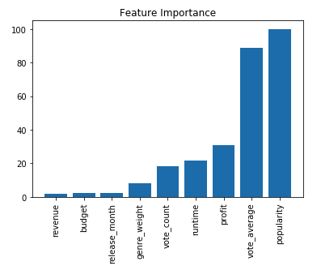
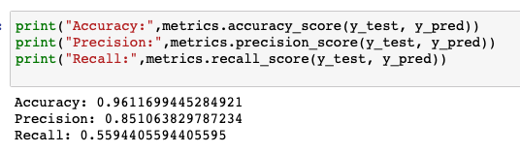
ACT FOUR: What does it take to be Nominated?
2019 Oscar Best Picture Movie
Nomination Prediction
Model Selection
Logistic Regression
XGBoost
Ensemble Training
Logistic, GuassianNB, RandomForest,ExtraTree and XGBoost

Slide 18
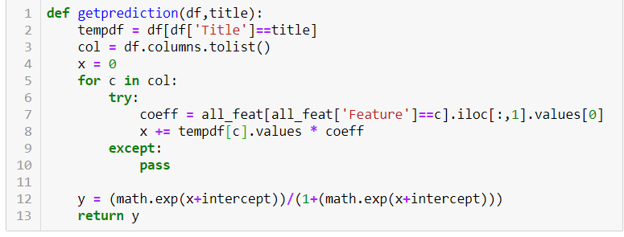
ACT FIVE: 2018 Prediction (broadcasted in Feb 2019)
Source of Best Picture Contenders: IndieWire.com
Assumption: If a contender film also had a front-runner contender for Best Director, Best Actor, Best Actress, Best Supporting Actor, Best Supporting Actress, it was considered a win.
Performed Logistic Regression on 49 features to determine each features’ weight.
See what features the contenders have and account for their weight.

Slide 19
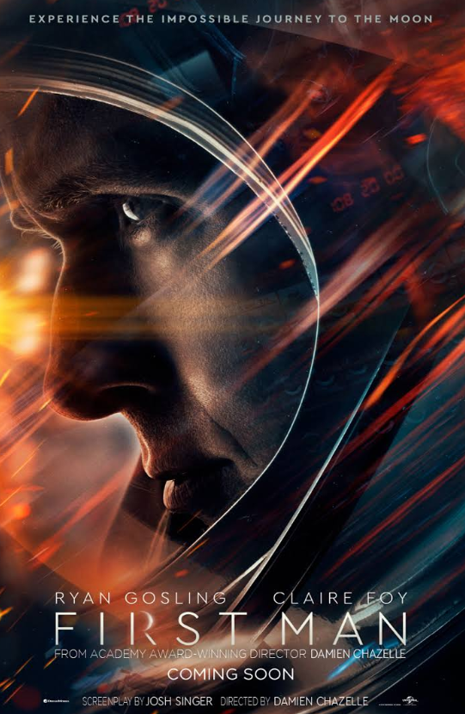
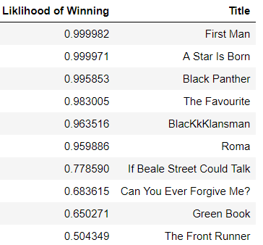

ACT FIVE: 2018 Prediction (broadcasted in Feb 2019)

Slide 20
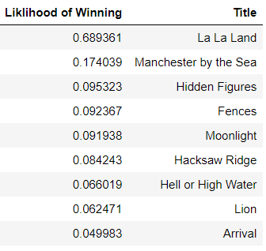
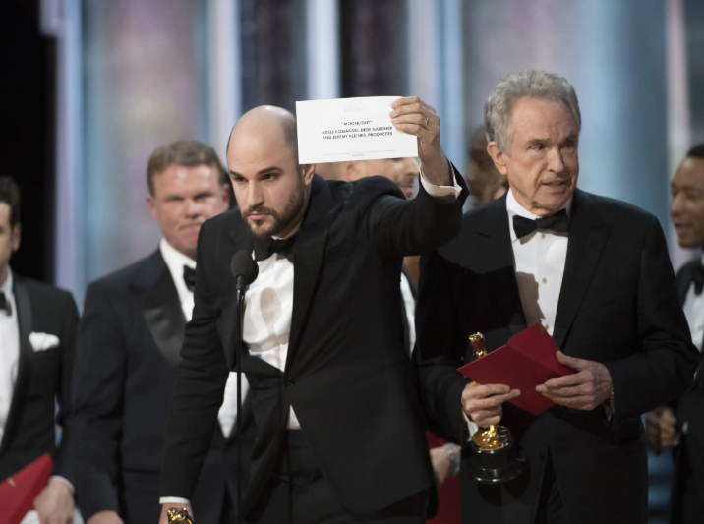
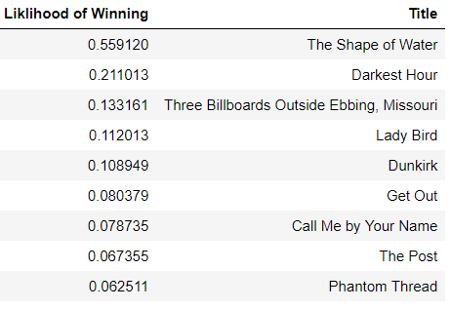
ACT FIVE: Is the Model Correct? Testing on 2016 and 2017 Data

Slide 21
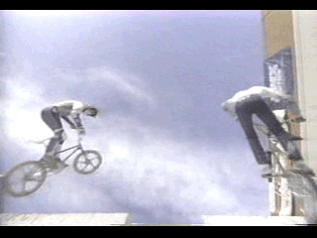
ACT FIVE: Implications
A model is only as good as the data you feed it!
Model does not take into account what movies a given movie will be facing in a given year (what does the competition look like?)
The training data looks at data from 1944-2015. the model treats the results from all years equally. In reality, the results of later years (e.g. post 2000s) are more indicative of what is likely to happen this year than the results of 1944.
Model does not take into account social issues (e.g. #OscarsSoWhite, demographics, Harvey Weinstein scandal….)

Slide 22
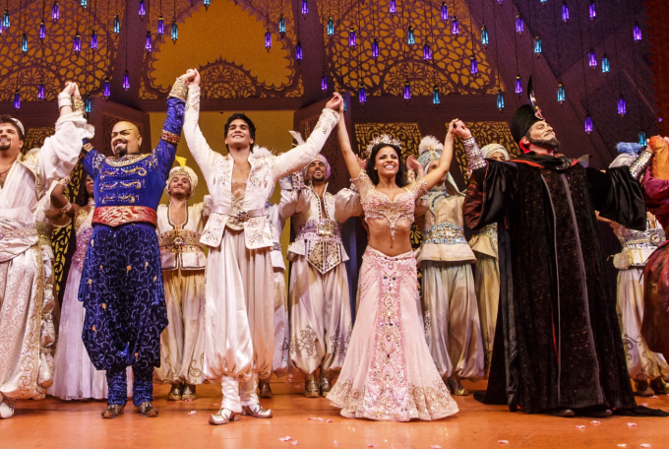
THE END
Jesse
Tao
Steve
Sara

